Slide 1
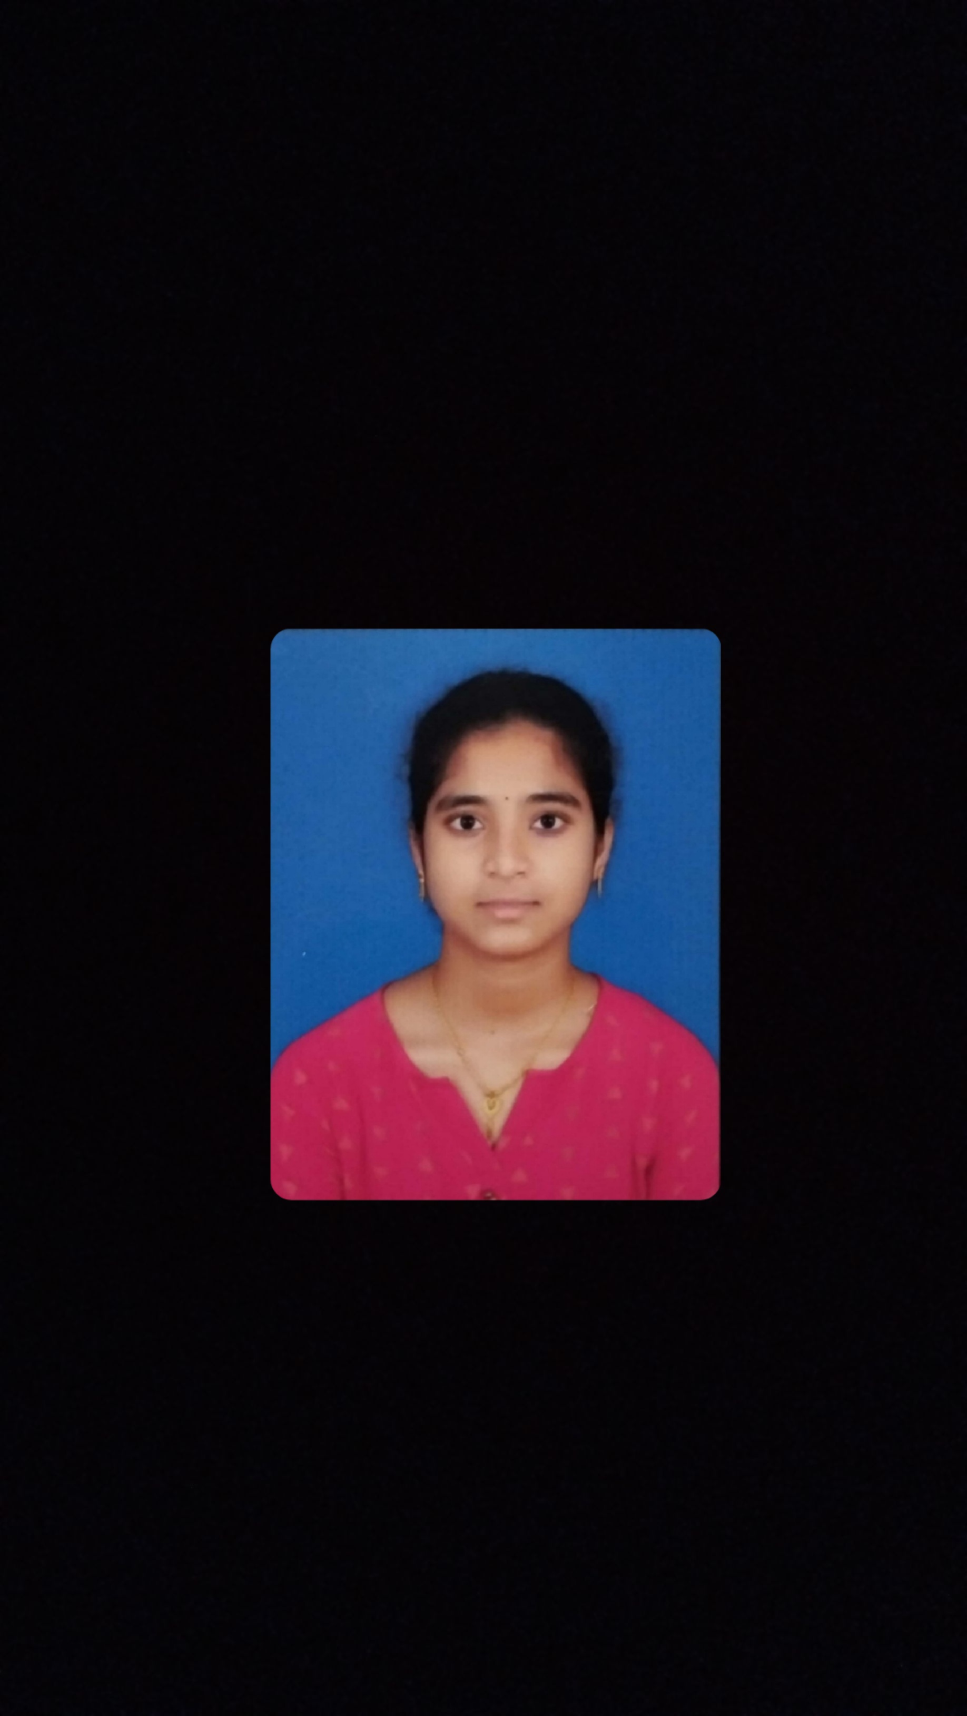

STUDENT DETAILS
Name : T.Pujitha
Skills-build Email ID: 2200050024ecs@gmail.com
College Name: KLUniversity
College State: Andhra Pradesh
Internship Domain & Internship Start & End Date:Cyber Security / 3rd June 2024 – 15th July 2024

Slide 2
STEGNOGRAPHY
TOPIC : HIDING MESSAGE IN AN IMAGE
Objective: The objective of the project is to develop a robust steganographic system for hiding messages in images, ensuring security and non-obviousness.
Problem Statement
The problem statement of hiding a message in an image involves concealing information within the pixels of a digital image so that the presence of the hidden data is not obvious to unintended observers. This technique, known as steganography, ensures that the image containing the hidden message appears unchanged to the naked eye.
Steganography tools and software facilitate this process by embedding the message data into the image file. This hidden message can be extracted later using specific algorithms or keys known only to the sender and intended recipient, ensuring confidentiality and security

Slide 3
AGENDA
The main concept of this project is to “Hiding a secret message in an Image”.
Using the Steganography Techniques we are implementing a code in python to deploy this project.
In this project the main library we used is “OpenCV ”.
The open cv library has many inbuilt functions for Image processing.

Slide 4
PROJECT OVERVIEW
The Image Steganography Project aims to create a system for securely embedding and extracting hidden messages within digital images. It involves researching existing techniques, developing robust algorithms for data embedding and extraction, and ensuring security through cryptographic methods. The project includes designing a user-friendly interface and testing for performance and robustness. Comprehensive documentation and user guides will be prepared. The final system will be deployed, ensuring the secure and imperceptible concealment of messages within images.

Slide 5
WHO ARE THE END USERS of this project?
Government agencies needing secure communication methods.
- Cybersecurity professionals seeking advanced data protection techniques.
- Journalists and activists requiring confidential information sharing.
- Businesses needing digital watermarking for intellectual property protection.
- IT departments ensuring data integrity and confidentiality.
- Academics and researchers in digital security and data privacy fields.
- Individuals desiring secure and covert communication methods.

Slide 6
YOUR SOLUTION AND ITS VALUE PROPOSITION
Our solution offers a robust value proposition centered on providing personalized AI-driven customer support solutions. Key elements of our value proposition include:
Problem Solving: Addressing the challenge of scaling customer support while maintaining quality through AI automation.
Unique Benefits: Offering a customizable AI platform that adapts to specific business needs, integrating seamlessly with existing systems.
Customer Value: Enhancing customer satisfaction with 24/7 availability, instant response times, and personalized interactions based on data insights.
Proof Points: Demonstrating significant efficiency gains and improved customer retention rates from client case studies and industry benchmarks

Slide 7
ADVANTAGES
Security: Unlike cryptography which encrypts data, steganography hides the existence of data, providing an additional layer of security.
Covert Communication: It allows secret communication where the very existence of the message can be concealed, often within innocent-looking digital media .
Capacity: Steganography can embed a significant amount of hidden data within digital files without noticeably altering the cover file, allowing for efficient data hiding .
Resistance to Attacks: When combined with encryption, steganography provides dual-layer protection, making it resilient against various forms of attacks .
Versatility: It can be applied to various types of digital media including images, videos, and audio files, offering flexibility in covert communication methods .

Slide 8
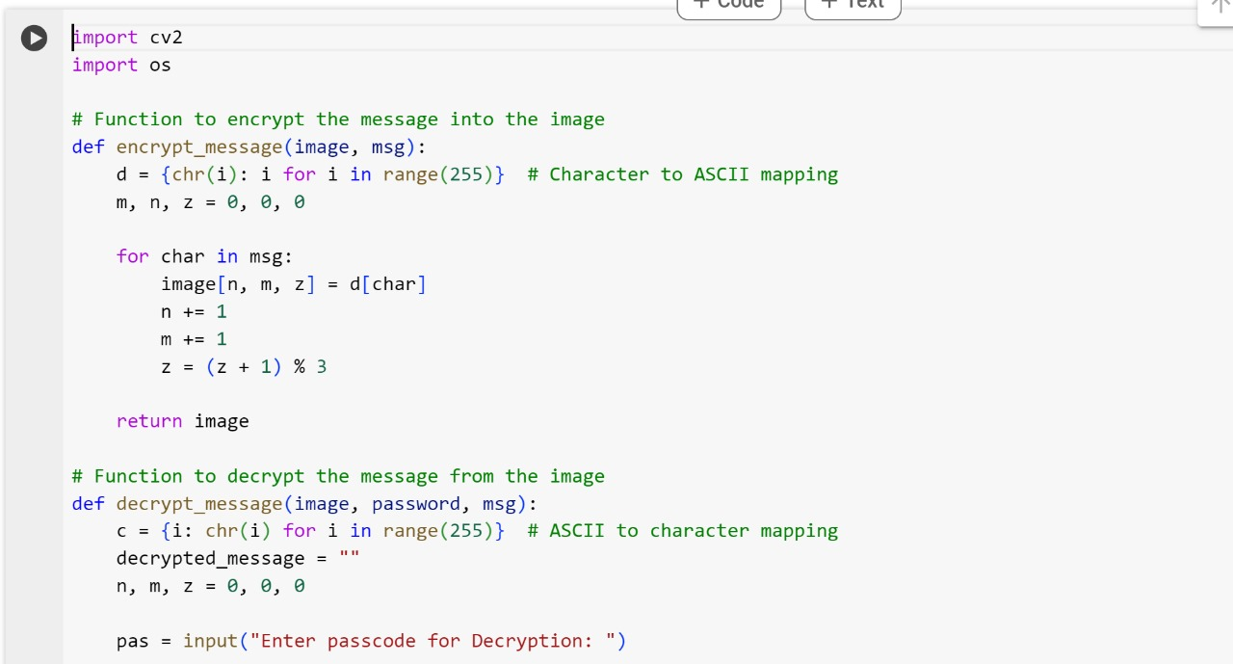
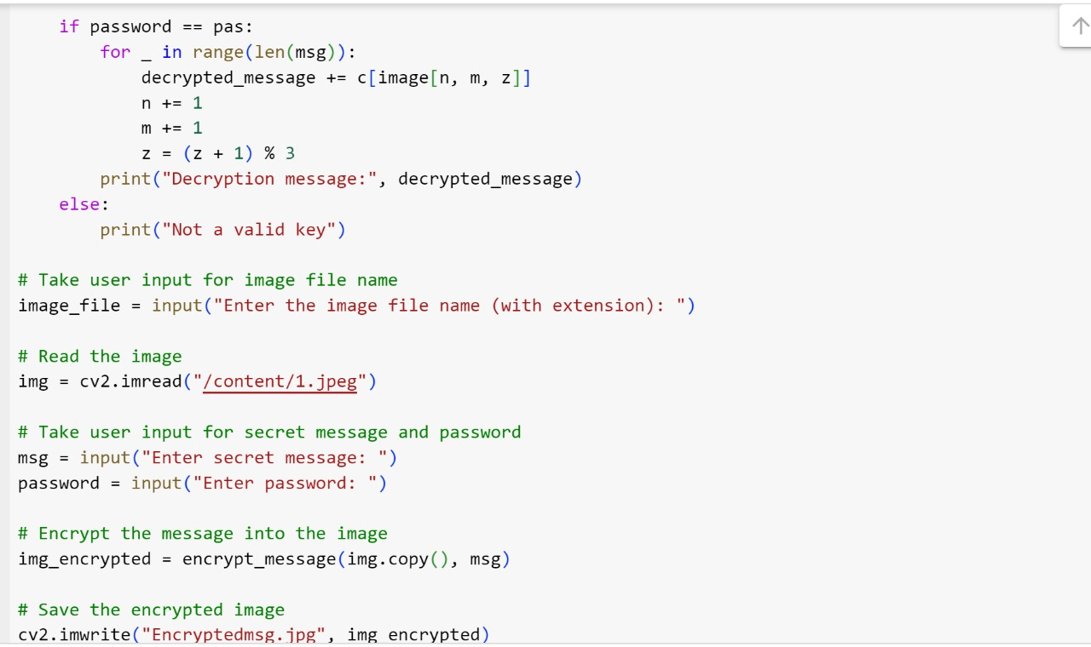
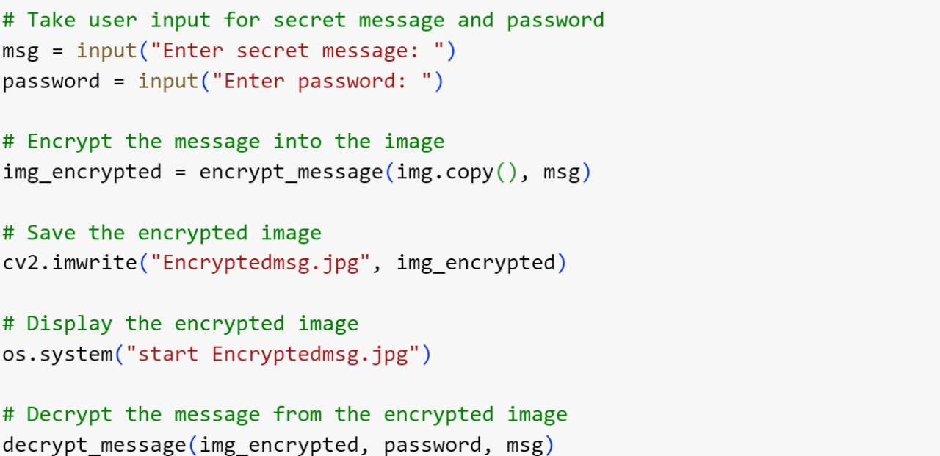
How did you customize the project and make it your own

Slide 9
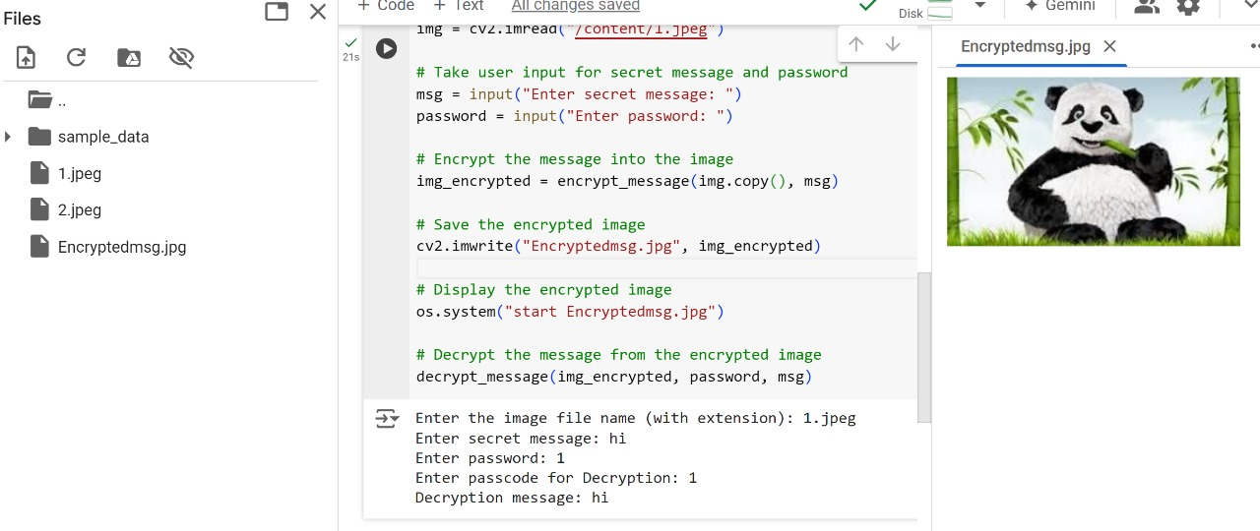
Results

Slide 10

IMAGES
Original Image
Encrypted Image

Slide 11
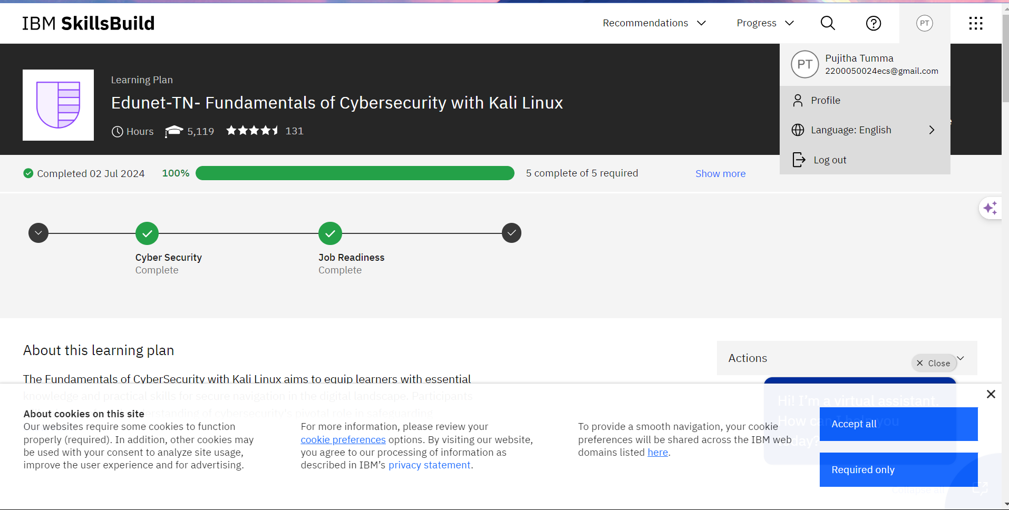
links
Here you can check the code that I had posted it in my “Git Hub Account”.
https://github.com/Pujitha007/stegnography

